Slide 1
Data Mining for Business
Lec 14, 3rd December 2019
Dr. Kamesam

Slide 2
Machine Learning -- A Summary
Every machine learning task has three key components:
Representation
Optimization
Evaluation
Machine Learning in Practice
Represent input through features the computer can understand
Learning
Algorithm
Test Model’s
Generalization
Representation Optimization Evaluation

Slide 3
Representation
An important task in Machine Learning:
How to transform / represent the input data? Which features would be helpful for the ML task?
If there are alternative representations of the same data, need to choose the representation that would provide strong predictors
Consider the following examples:
Feature definition of Iris Flowers. (Petal Length, Petal Width, Sepal Length, Sepal Width)
Feature selection on Insects Katydid, Grasshopper
Definition of features to predict forest cover
Feature extraction from S&P 500 closing prices (Group project spring 2019 )
see excel sheet

Slide 4
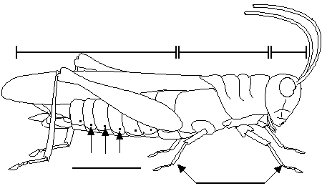
Feature Selection
Which Features would help classify ?
Color {Green, Brown, Gray, Other} ?
Has Wings?
Abdomen
Length
Thorax Length
Antennae
Length
Mandible
Size
Spiracle
Diameter
Leg Length

Slide 5
Optimization
Once you choose the representation, search for the best model, through Optimization
Combinatorial optimization
E.g.: Greedy search Decision Trees
Nonlinear optimization ANN, Log. Reg
E.g.: Gradient descent
Constrained optimization SVM
E.g.: Linear or Nonlinear Programming

Slide 6
Evaluation
Evaluating a model, or comparing models through Evaluation metrics
Accuracy
Precision, recall, F-measure
Entropy
Sum of Squared error
Likelihood
Posterior probability
Gain , Lift
Cost / Utility
Margin
K-L divergence
ROC, AUC
Etc.

Slide 7
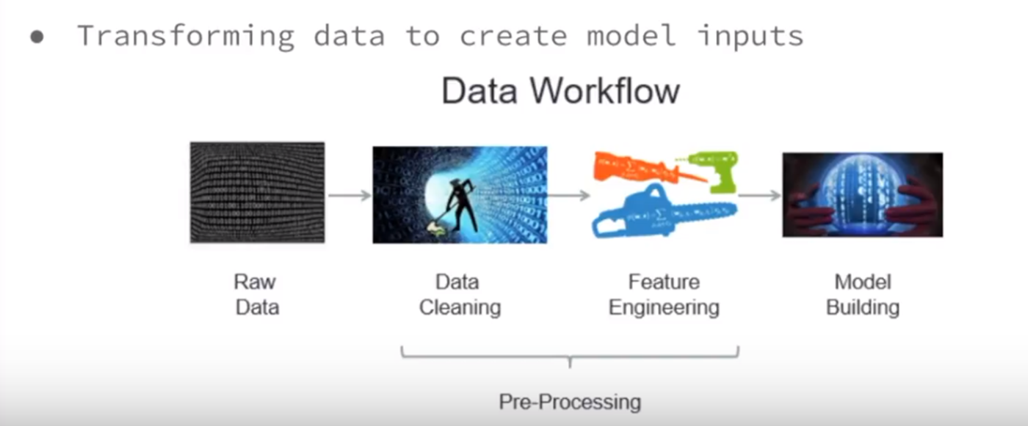
Data Science Work Flow

Slide 8
Data mining is a process
science + craft + creativity + common sense
a process

Slide 9
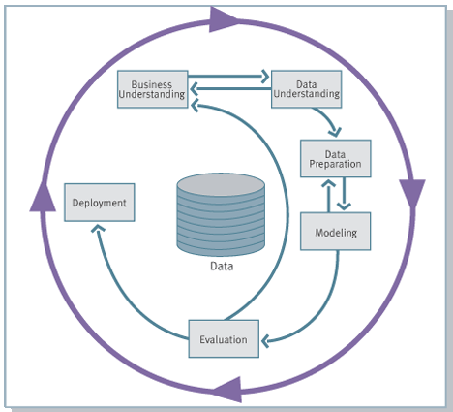
The CRISP Data Mining Process
Cross Industry Standard Process for Data Mining

Slide 10
The Data Mining Process

Slide 11
The Data Mining Process

Slide 12
Data Mining for Business
Improving the performance of Machine Learning Algorithms
Dr. Kamesam

Slide 13
Improving performance of ML Algorithms
1. Larger training dataset, More features
-- With large data, most algorithms will perform better
2. Features with more predictive power -- collect data and add
-- ex: House price prediction → add location (longitude, latitude)
3. Feature Engineering: create new features from existing features / data. Needs good domain and dataset understanding
-- ex: Stock Prices and short term trading
4. Ensembles: Ensembles can often lead to improved performance
-- ex 1: Random Forest often performs better than individual classifiers
-- ex 2: XGM (Extreme Gradient Boosting) also performs well

Slide 14
Improving performance of ML Algorithms, continued
5. Higher Dimensional Techniques
Support Vector Machines (SVM) classifier
6. Deep learning, if appropriate
Needs large datasets
Semi Supervised Learning:
When labelled data is limited, or expensive to collect.
Many successes.

Slide 15
Ensemble Learning
The following Ensemble techniques often outperform traditional ML algorithms
Random Forests
Adaboost
Gradient Boosting
Extreme Gradient Boosting (XGB)

Slide 16
Higher Dimensional Techniques
Support Vector Machines (SVM) is a classification technique for building a
Linear classification boundary, or
A nonlinear classification boundary (by using a Kernel)

Slide 17
Classifier for Linearly Separable data
Binary classification can be viewed as the task of separating classes in feature space:
w^{T}x + b = 0
w^{T}x + b > 0
w^{T}x + b < 0
f(x) = sign(w^{T}x + b)

Slide 18
Classifier for Linearly Separable data
Which of the linear classifiers is optimal?

Slide 19
Classification Margin
Distance from example x_{i} to the separator is
Examples closest to the hyperplane are support vectors.
Margin ρ of the separator is the distance between support vectors.
ρ
r
Notes:
支持向量机

Slide 20
SVM :Maximum Margin Classification
Maximizing the margin is good according to intuition and PAC theory.
Implies that only support vectors matter; other training examples are ignorable.
Notes:
最大间隔分类器
当超平面离数据点的“间隔”越大，分类的确信度（confidence）也越大

Slide 21
Soft Margin Classification
What if the training set is not linearly separable?
Slack variables ξ_{i} can be added to allow misclassification of difficult or noisy examples, resulting margin is called soft.
ξ_{i}
ξ_{i}

Slide 22
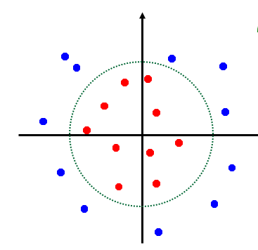
Linear Vs. Non-linear SVMs
Datasets that are linearly separable with some noise work out great:
But what are we going to do if the dataset is just too hard?
0
x
0
x

Slide 23
Projection into a higher dimensional space
But what are we going to do if the dataset is just too hard?
How about… mapping data to a higher-dimensional space:
0
x
x²
0
x

Slide 24
Non-linear SVMs: Feature spaces
General idea: the original input space can always be mapped to some higher-dimensional feature space where the training set is linearly separable:
Φ: x → φ(x)

Slide 25
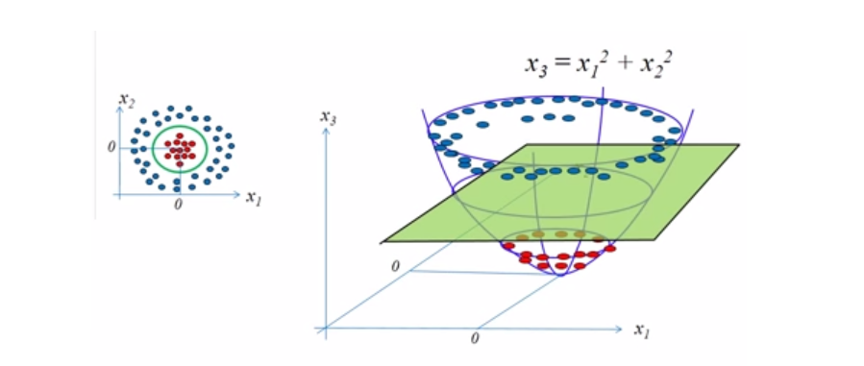
Higher Dimensional Transformation
Kernels

Slide 26
We can not get perfect accuracy with a linear classifier…
Higher Dimensional
Technique?

Slide 27
The simple linear classifier is defined for higher dimensional spaces…

Slide 28
… we can visualize it as being an n-dimensional hyperplane

Slide 29
Semi-Supervised Learning

Slide 30
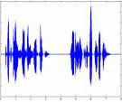

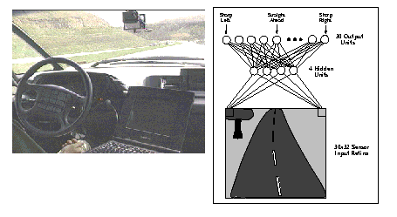
Supervised Learning has many successes
recognize speech,
steer a car,
classify documents
classify proteins
recognizing faces, objects in images
...

Slide 31
However, for many problems, labeled data can be rare or expensive. Unlabeled data is much cheaper.
Need to pay someone to do it, requires special testing,…

Slide 32
However, for many problems, labeled data can be rare or expensive. Unlabeled data is much cheaper.
Need to pay someone to do it, requires special testing,…
Speech Images Medical outcomes
Customer modeling Protein sequences Web pages

Slide 33
However, for many problems, labeled data can be rare or expensive. Unlabeled data is much cheaper. Can we make use of cheap unlabeled data?
Need to pay someone to do it, requires special testing,…

Slide 34
Semi-Supervised Learning
Can we use unlabeled data to augment a small labeled sample to improve learning?
But unlabeled data is missing the most important info!!
But maybe still has useful regularities that we can use.
But, but, but

Slide 35


Semi-Supervised Learning
Can we use unlabeled data to augment a small labeled sample to improve learning?
But unlabeled data is missing the most important info!!
But maybe still has useful patterns that we can use.
But…
But…
But…

Slide 36
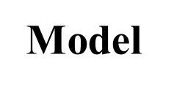
Semi-supervised Learning
Training Data
Supervised
Learning
All Labeled Data
Model
UnSupervised
Learning
All Unlabeled Data
Some
labeled Data
Semi-Supervised
Learning
Lots of
Unlabeled Data

Slide 37
Semi-Supervised Learning
Self Training Algorithm
Build a classifier with the limited labeled data
Classify the Unlabeled using the classifier.
Pick the record with the most confident prediction and add to labeled data.
Note that #training (labeled) records increased by one.
Rebuild the classifier, and repeat the above steps

Slide 38
Semi-Supervised: “Self Learning”
Supervised
Labeled data
Training process
Semi-supervised
Labeled
Training process
Unlabeled
Labeled

Slide 39
Semi-Supervised Learning
Substantial recent work in ML. A number of interesting methods have been developed.
Self Training
Cotraining
Active Learning
Transfer Learning

Slide 40
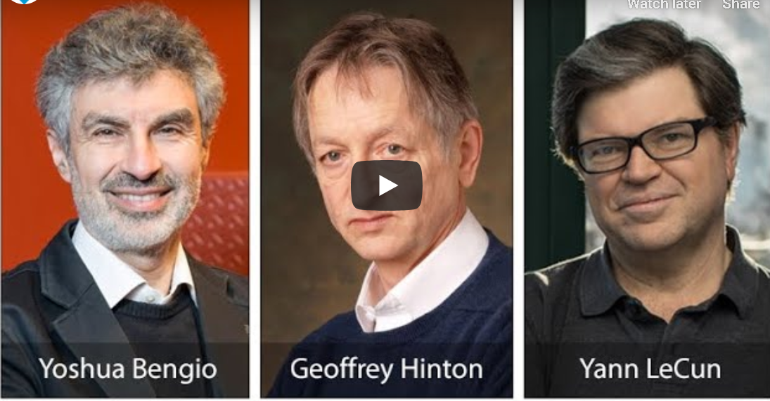
Deep Learning
Deep Learning (DL) is a relatively new development
Around 2010, DL algorithms started outperforming other ML techniques.
first in speech recognition and computer vision, then NLP
Yoshua Bengio, Geoffrey Hinton, and Yann LeCun win
2018 ACM Turing Award for breakthroughs in deep neural networks

Slide 41


ML vs. Deep Learning
ML can work well if the input data is well represented by the extracted features
ML works well because of human-designed representations and input features
Machine Learning in Practice
Represent input through features the computer can understand
Learning
Algorithm
Test Model’s
Generalization
Requires Domain specific
Knowledge, and high skill
Optimize
Model parameters
Evaluate
Generalization

Slide 42
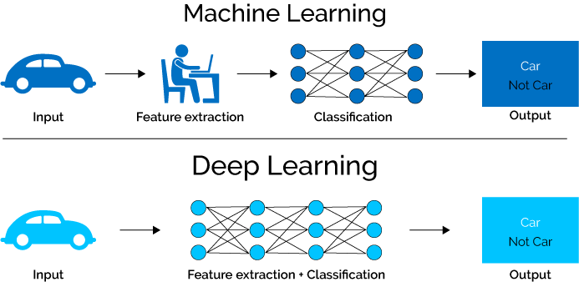
What is Deep Learning (DL) ?
A subfield of ML. Exceptionally effective at learning patterns.
DL algorithms learn (multiple levels of) representation by using a hierarchy of layers
With tons of information, it begins to understand it and respond in useful ways.

Slide 43
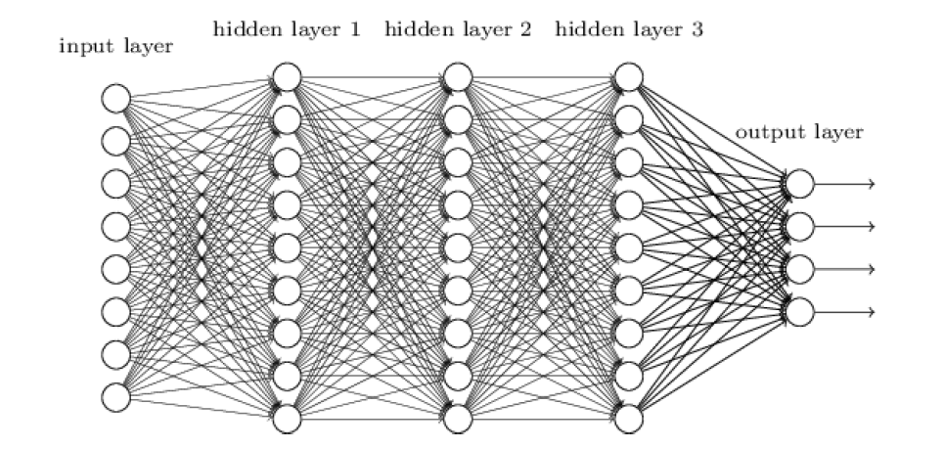
What is Deep Learning (DL) - 2
All Deep Learning models are based on Artificial Neural Nets.
Deep Learning models use ANN with several hidden layers between input and output
The first few layers perform feature extraction
Often, custom architectures (CNN, RNN) are used.

Slide 44
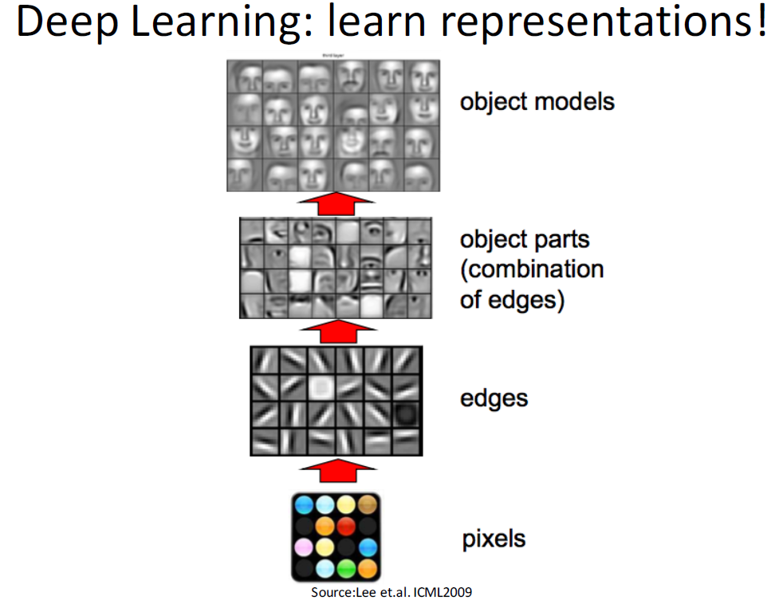

Slide 45
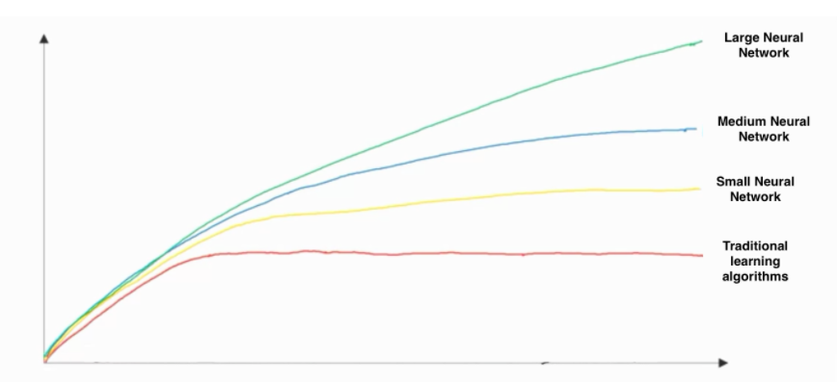
Larger Datasets and Deep Learning Performance of Machine Learning Algorithms
Performance
# training records
Source:Andrew Ng.

Slide 46
End Of Lecture

Slide 47
More on SVM

Slide 48
Linear SVMs: Overview
The classifier is a separating hyperplane.
Most “important” training points are support vectors; they define the hyperplane.
Quadratic optimization algorithms can identify which training points x_{i} are support vectors with non-zero Lagrangian multipliers α_{i}.
Both in the dual formulation of the problem and in the solution training points appear only inside inner products:
Find α₁…α_{N} such that
Q(α) =Σα_{i} - ½ΣΣα_{i}α_{j}y_{i}y_{j}x_{i}^{T}x_{j} is maximized and
(1) Σα_{i}y_{i} = 0
(2) 0 ≤ α_{i} ≤ C for all α_{i}
f(x) = Σα_{i}y_{i}x_{i}^{T}x + b

Slide 49
What Functions are Kernels?
For some functions K(x_{i},x_{j}) checking that K(x_{i},x_{j})= φ(x_{i}) ^{T}φ(x_{j}) can be cumbersome.
Mercer’s theorem: Every semi-positive definite symmetric function is a kernel
Semi-positive definite symmetric functions correspond to a semi-positive definite symmetric Gram matrix:
K(x₁,x₁) | K(x₁,x₂) | K(x₁,x₃) | … | K(x₁,x_{n})
K(x₂,x₁) | K(x₂,x₂) | K(x₂,x₃) |  | K(x₂,x_{n})
… | … | … | … | …
K(x_{n},x₁) | K(x_{n},x₂) | K(x_{n},x₃) | … | K(x_{n},x_{n})
K=

Slide 50
Examples of Kernel Functions
Linear: K(x_{i},x_{j})= x_{i}^{T}x_{j}
Mapping Φ: x → φ(x), where φ(x) is x itself
Polynomial of power p: K(x_{i},x_{j})= (1+ x_{i}^{T}x_{j})^{p}
Mapping Φ: x → φ(x), where φ(x) has dimensions
Gaussian (radial-basis function): K(x_{i},x_{j}) =
Mapping Φ: x → φ(x), where φ(x) is infinite-dimensional: every point is mapped to a function (a Gaussian); combination of functions for support vectors is the separator.
Higher-dimensional space still has intrinsic dimensionality d (the mapping is not onto), but linear separators in it correspond to non-linear separators in original space.
Go Back

Slide 51
The “Kernel Trick”
The linear classifier relies on inner product between vectors K(x_{i},x_{j})=x_{i}^{T}x_{j}
If every datapoint is mapped into high-dimensional space via some transformation Φ: x → φ(x), the inner product becomes:
K(x_{i},x_{j})= φ(x_{i}) ^{T}φ(x_{j})
A kernel function is a function that is eqiuvalent to an inner product in some feature space.
Example:
2-dimensional vectors x=[x₁ x₂]; let K(x_{i},x_{j})=(1 + x_{i}^{T}x_{j})²,
Need to show that K(x_{i},x_{j})= φ(x_{i}) ^{T}φ(x_{j}):
K(x_{i},x_{j})=(1 + x_{i}^{T}x_{j})²,= 1+ x_{i1}²x_{j1}² + 2 x_{i1}x_{j1} x_{i2}x_{j2}+ x_{i2}²x_{j2}² + 2x_{i1}x_{j1} + 2x_{i2}x_{j2}=
= [1 x_{i1}² √2 x_{i1}x_{i2} x_{i2}² √2x_{i1} √2x_{i2}]^{T} [1 x_{j1}² √2 x_{j1}x_{j2} x_{j2}² √2x_{j1} √2x_{j2}] =
= φ(x_{i}) ^{T}φ(x_{j}), where φ(x) = [1 x₁² √2 x₁x₂ x₂² √2x₁ √2x₂]
Thus, a kernel function implicitly maps data to a high-dimensional space (without the need to compute each φ(x) explicitly).

Slide 52
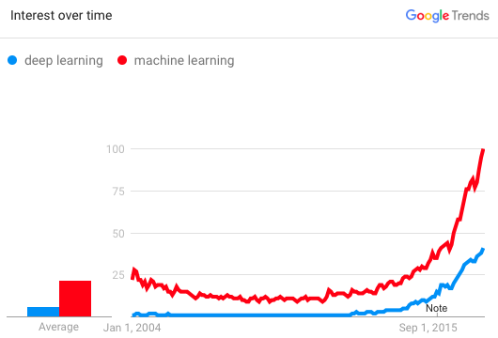
Why is DL useful?
Manually designed features are often over-specified, incomplete and take a long time to design and validate
Learned Features are easy to adapt, fast to learn
Deep learning provides a very flexible, (almost?) universal, learnable framework for representing world, visual and linguistic information.
Can learn both unsupervised and supervised
Effective end-to-end joint system learning
Utilize large amounts of training data
In ~2010 DL started outperforming other ML techniques
first in speech and vision, then NLP

